Slide 1


KEEP IT DRY
Product review:
Super Soaker
BAN 502- Project Phase 1
Andrea Johnson

Slide 2

Project purpose
This project presents an opportunity to help the fictional company Keep It Dry improve its main product Super Soaker. The product is used in factories to absorb spills and leaks.
The company has just completed a large testing study for different product prototypes.
The purpose is to analyze the data to find any predictors of the “failure” variable.

Slide 3

Organizing and Cleaning the data
The dataset “train” is composed of 26570 observations and 26 variables.
The following were changed to factors from characters:
failure
attribute_0
attribute_1
There was quite a bit of missing data in the data set. I chose to use predictive mean matching to fill in these gaps.

Slide 4
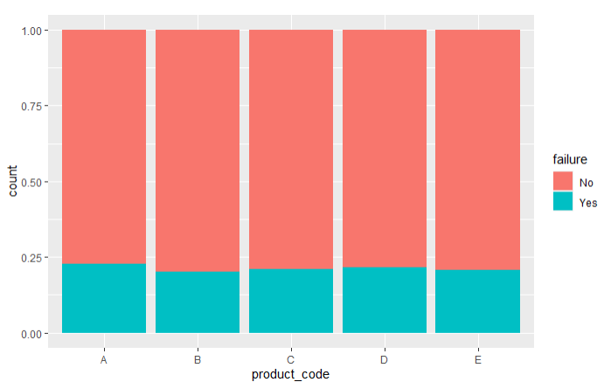
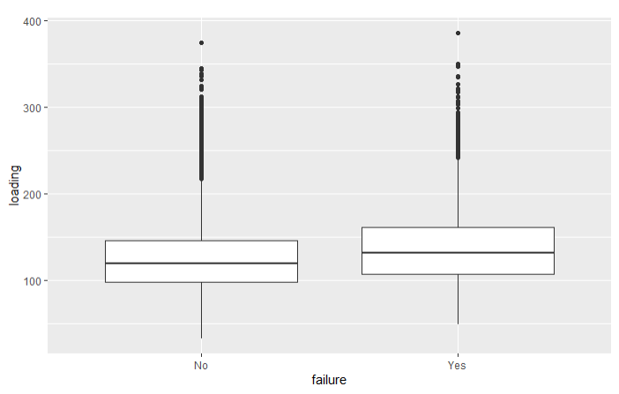
Findings
I first looked at the product code and loading variables against failure.
I was unable to see any clear indicators of failure here, as the number of failures was similar across all products and loading sizes.

Slide 5
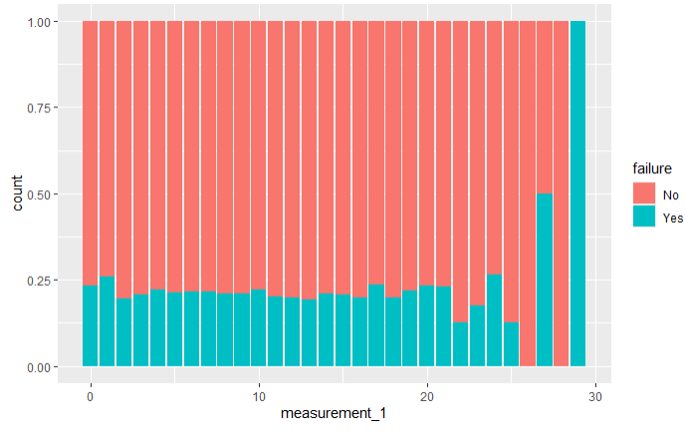
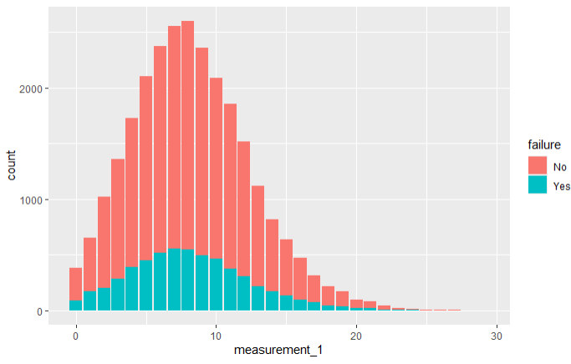
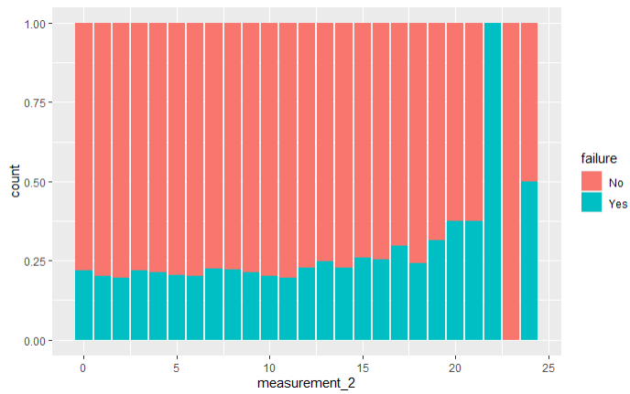
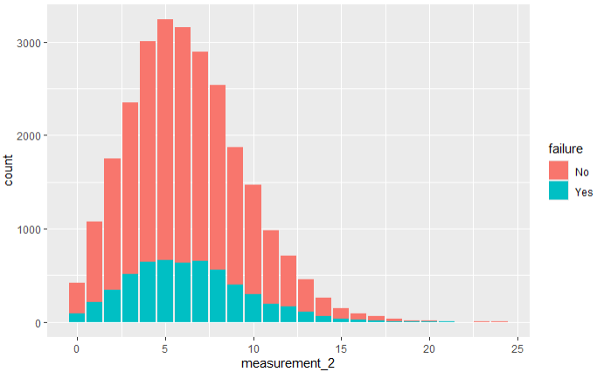
Findings
I then looked the failure variable against each “measurement” variable.
I did notice a very small indicator of 100% failure at measurement_1, 29 and measurement_2, 22.
These would not be considered predictors of failure, as they represent a very small proportion of the whole variable.

Slide 6
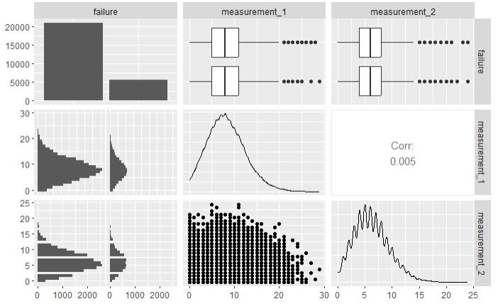
Correlations
I wanted to see if there was any correlation between the failure variable and the two measurement variables (1 & 2).
I was unable to see any clear correlation between these.

Slide 7
Conclusion
In conclusion, I was unable to find any clear predictors of the failure variable in the dataset. Further analysis would need to be conducted for the company to gain additional insight into potential failures in the product design.
7

